Slide 1

Internet of Things using .NET
Using Raspberry PI and Mono C# to build an IoT device.

Slide 2
Chris Berthold
Over 15 years of development experience developing quality software and network administration
10 years of business development in a manufacturing setting
6 years of development as software consultant
Private pilot
Currently works on the awesome Product Development Team for Flightdocs

Slide 3

Cisco IBSG 2011 Infographic

Slide 4
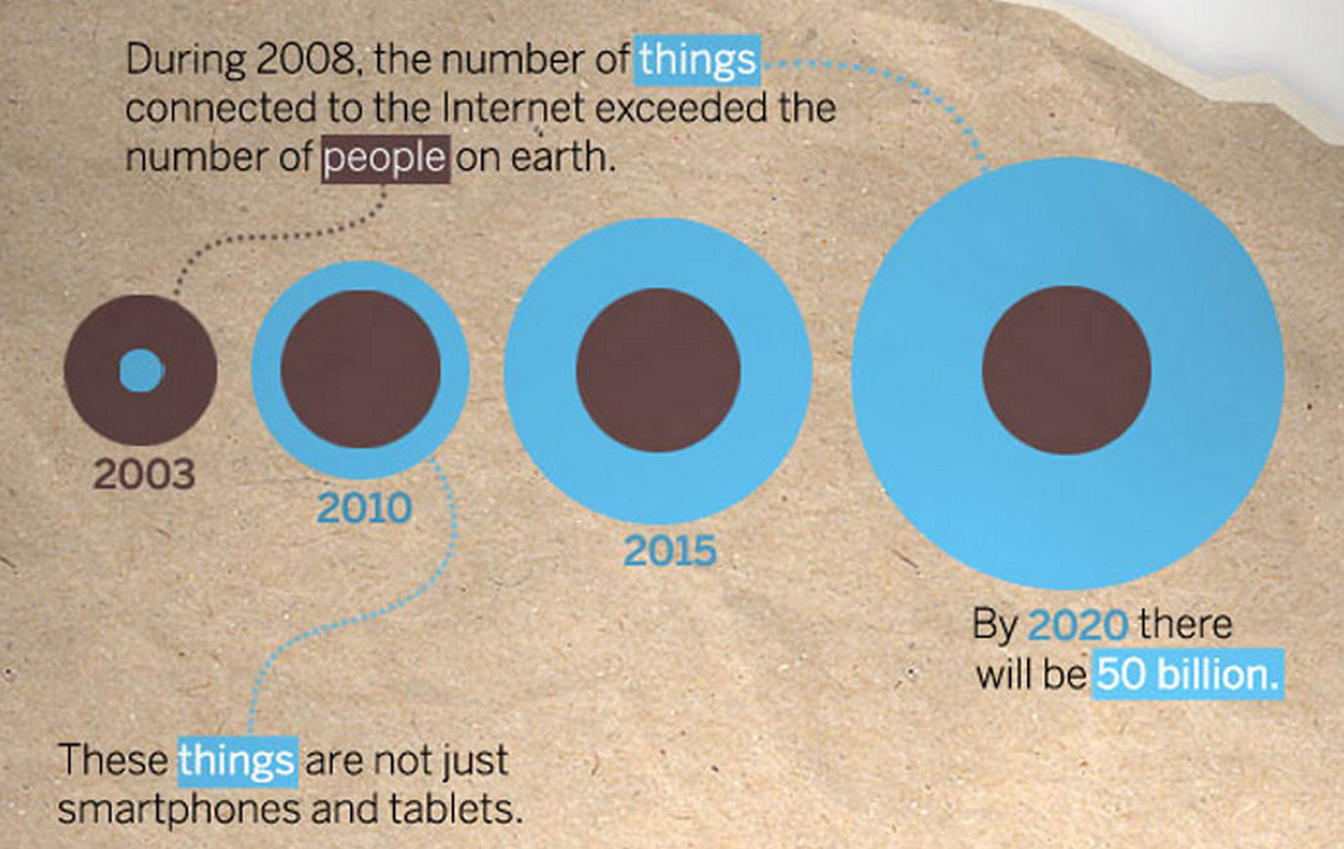
Cisco IBSG 2011 Infographic

Slide 5

Introducing Raspberry Pi 2
The Raspberry Pi is a series of credit card-sized single-board computers developed in the UK by the Raspberry Pi Foundation with the intention of promoting the teaching of basic computer science in schools.
Because it has an ARMv7 processor, it can run the full range of ARM GNU/Linux distributions, including Snappy Ubuntu Core, as well as Microsoft Windows 10 (see the blog for more information)

Slide 6

Building The Platform
NOOBS Installation

Slide 7
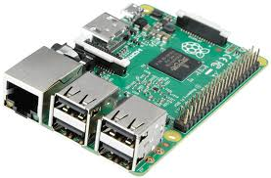
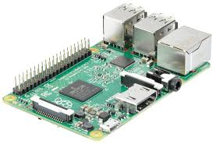
Raspberry Pi 2

Slide 8
Features and Specifications
A 900MHz quad-core ARM Cortex-A7 CPU
1GB RAM
4 USB ports
40 GPIO pins
Full HDMI port
Ethernet port
Combined 3.5mm audio jack and composite video
Camera interface (CSI)
Display interface (DSI)
Micro SD card slot
VideoCore IV 3D graphics core

Slide 9
What you need to get started
A MicroUSB Power supply capable of 1.5Amps (2 amps suggested) – Samsung Galaxy S5 for example
A MicroSD card compatible with Raspberry PI 2
Not all cards are created equal
Recommend the NOOBS cards – great place to start and no issues
A TV with HDMI to plug into or a USB to TTL Serial Cable
A WIFI Dongle or Ethernet Cable for internet access

Slide 10
What is Internet of Things?
The Internet of Things (IoT) is the network of physical objects or "things" embedded with electronics, software, sensors and connectivity to enable it to achieve greater value and service by exchanging data with the manufacturer, operator and/or other connected devices. Each thing is uniquely identifiable through its embedded computing system but is able to interoperate within the existing Internet infrastructure.

Slide 11
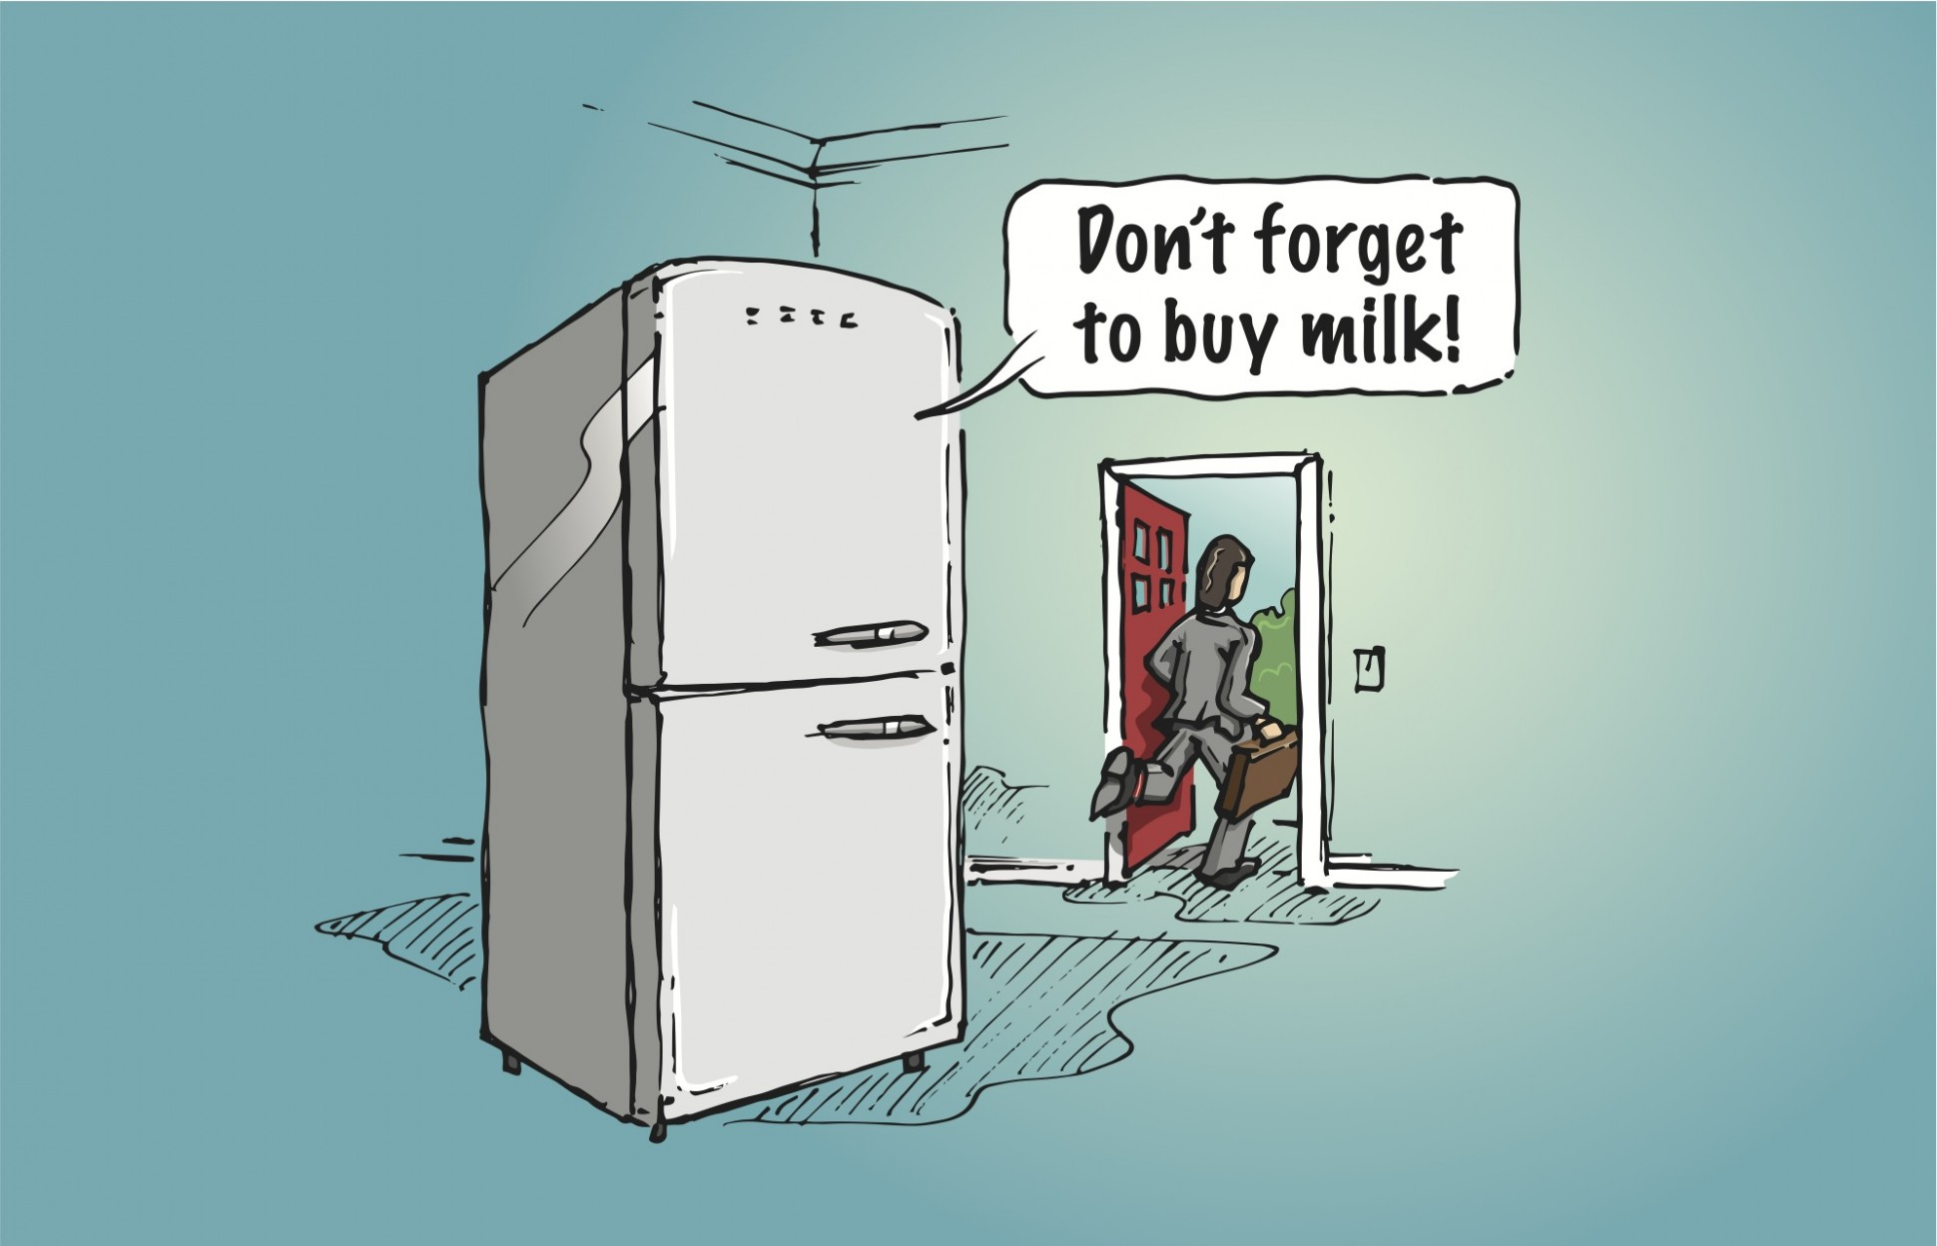

Slide 12

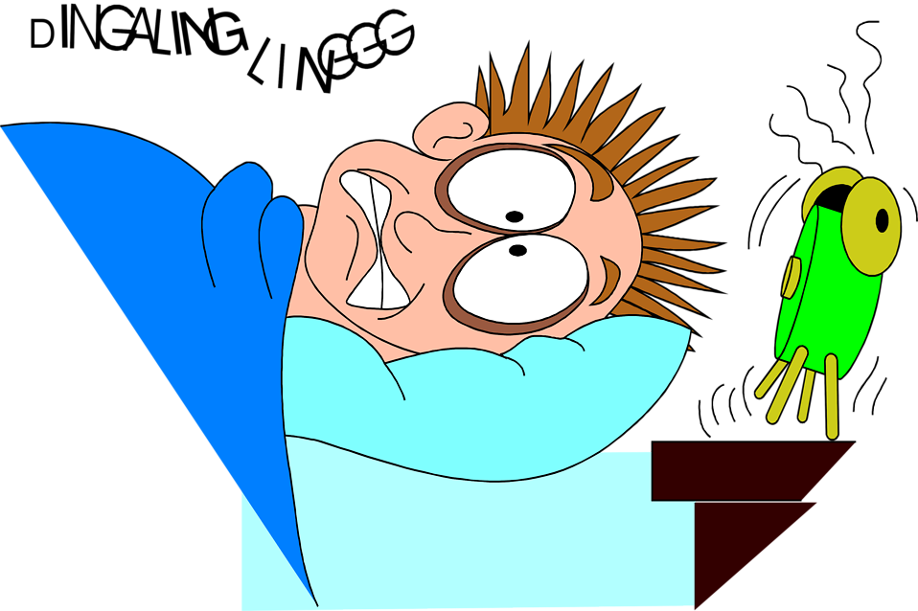



In ENGLISH Please!
Alarm Activated
Snooze Pressed
Toilet Bowl Cleaner Empty

Slide 13
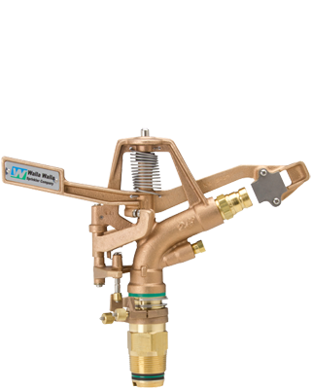

Internet of Things: Operations
Input
Encode
Orchestrate
Encode
Output
Events
Events

Slide 14
Types of Input and Output
Analog – A continuous signal for which the time varying feature (variable) of the signal is a representation of some other time varying quantity.
Audio – Voltage varies with sound waves
Pressure – Aneroid barometer uses rotary position
Digital – Finite number of values or steps (usually defined as exact voltage values)
Switch – On/Off
Gear Shifter – Park/Netural/Reverse/1/2/3
Encoded – Device, circuit, transducer, software, algorithm or person that converts information from one format or code to another, for purposes of standardization, speed, secrecy, or compressions
Morse Code, Enigma
BlueTooth Sound
Web Services

Slide 15


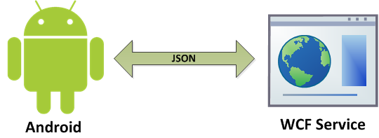
Inputs
Analog
Microphone
Temperature Sensors
CO2 Sensors
Radio Signal
Encoded
BlueTooth Device
Web Service
Serial Device
USB Device
Inter-Integrated Circuit (I2C) Device
Digital
Relay
Switch
GPIO – General Purpose Input Output

Slide 16
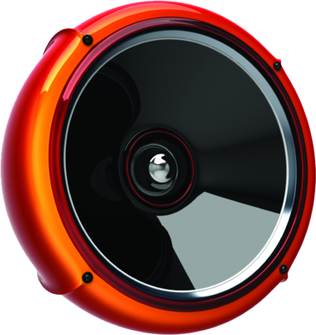

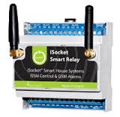
Outputs
Analog
Speakers
Light Bulb
Radio Signal
Encoded
BlueTooth Device
Web Service
Serial Device
USB Device
Inter-Integrated Circuit (I2C) Device
Digital
Relay
Multi Position Switch
PWM – Pulse Wave Modulation
Motors
Actuators

Slide 17
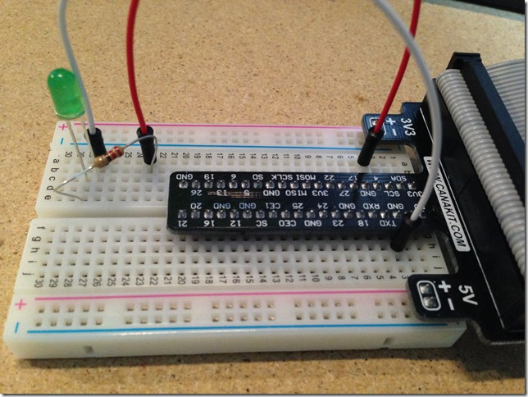

Example of Direct IO in C#
Hello world Blinky LED Light

Slide 18
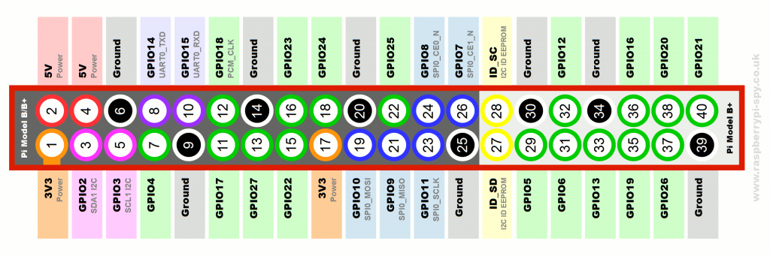
GPIO PinOut

Slide 19
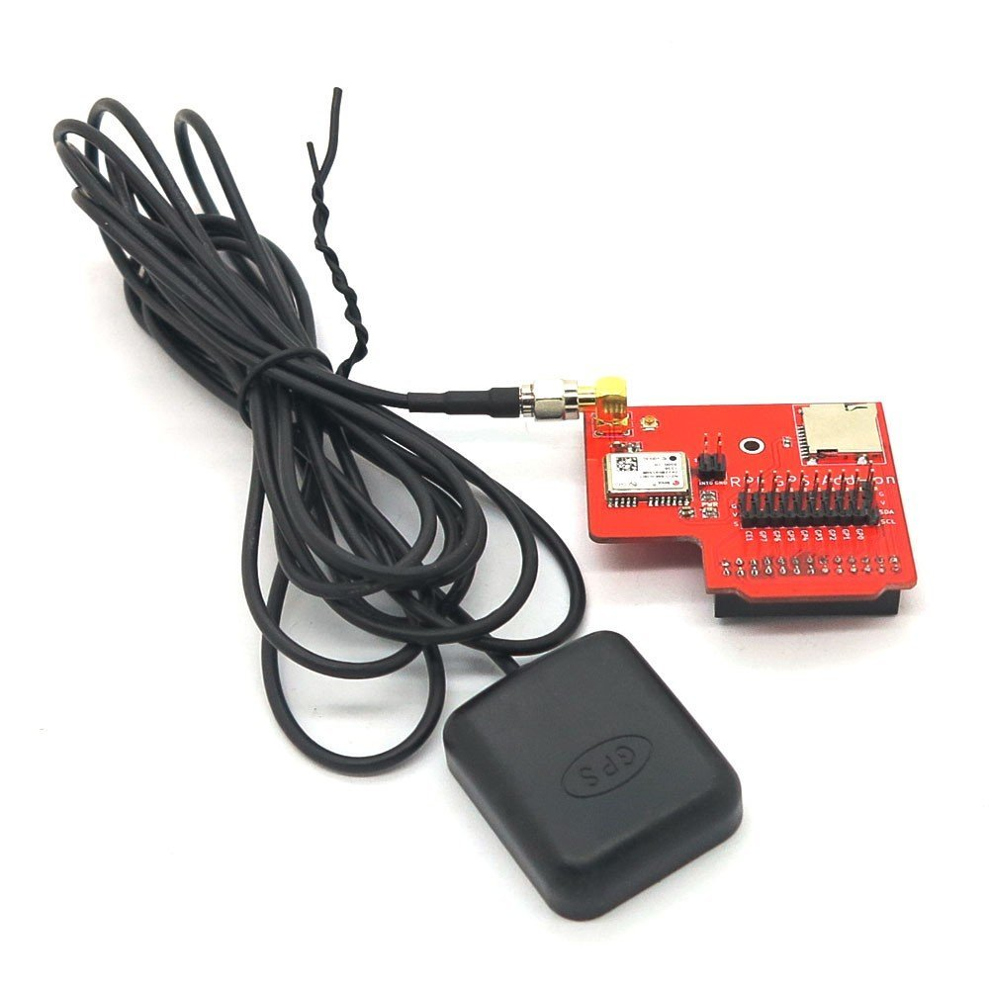
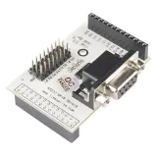
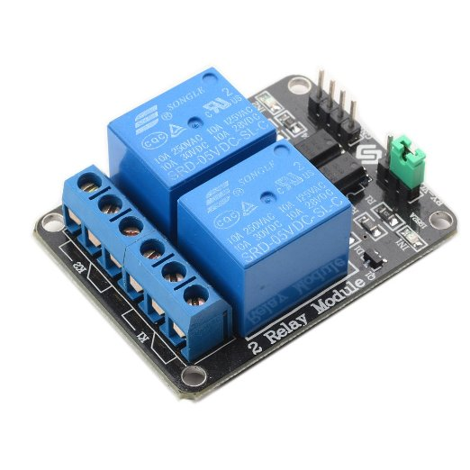
Using a Shield with Raspberry Pi
GPS Shield
Serial Shield
Relay Shield

Slide 20
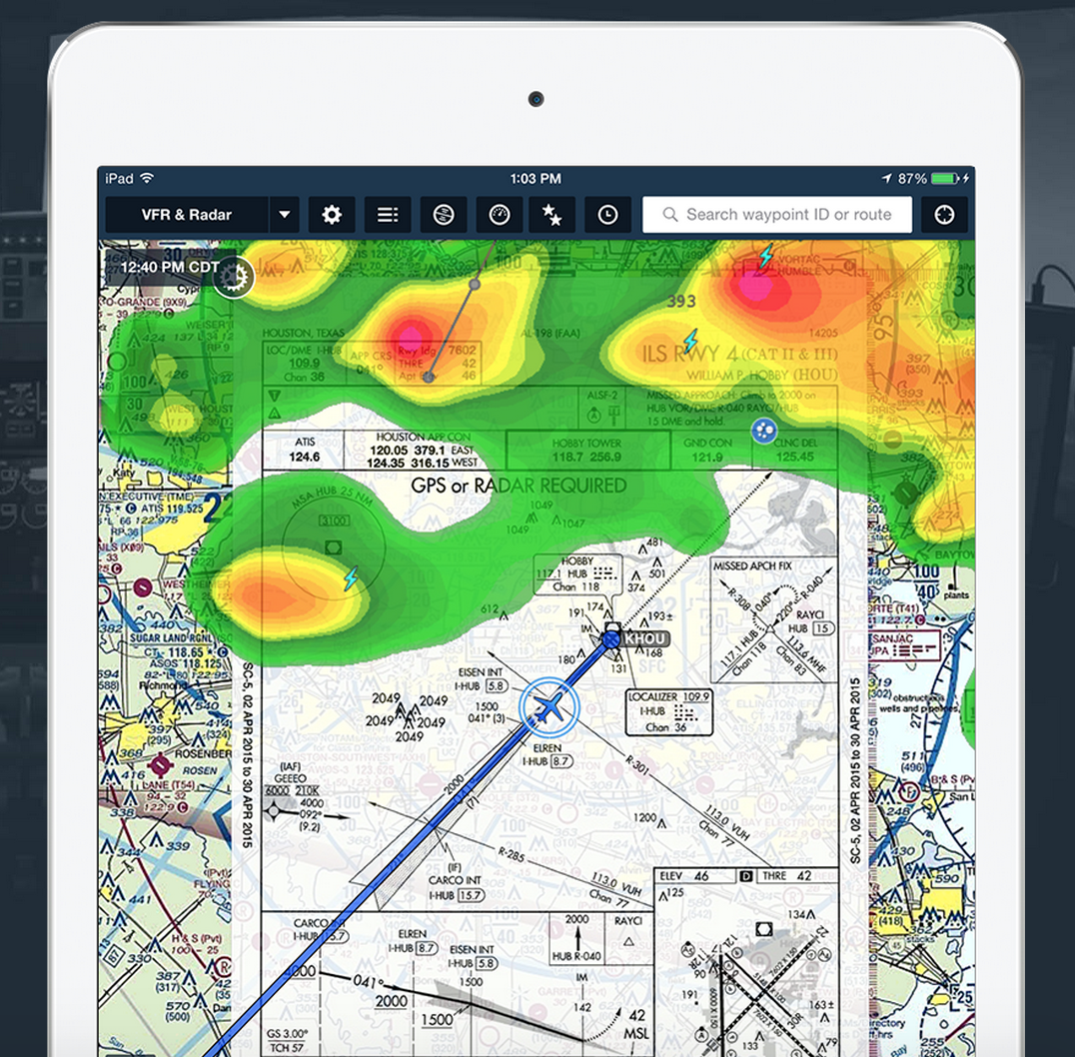
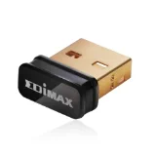
GPS Signal to ForeFlight
Raspberry Pi 2
Mono C#
Network Broadcast
GPS Shield
+

Slide 21
What will it do?
C# application
Orchestrates the inputs
Converts data
Responds to changes in position
Outputs response on regular 1 second interval according to ForeFlight API
Uses Reactive Extensions and Spatial.NET to create events for input and output
INPUT
GPS Module
gpsd
Encoded to NMEA GPS encoding
TCP localhost
Port 2947
Output
UDP Broadcast
ForeFlight Encoded format
Xxx.xxx.xxx.255
Port 49002

Slide 22
Wrapping up – Q & A
Getting time for beer but always glad to field questions
Hope you enjoyed the presentation
If you think I’m going to write at least one more bullet point you may be right
I can fit more you know……
OK last one, have a good night, Thanks for coming!

